Slide 1
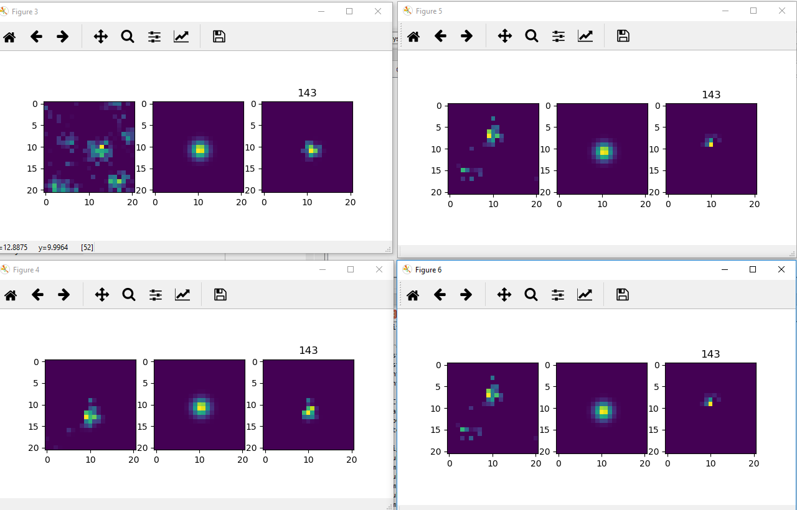
Test alignment+trace extraction
Fig3: donor
Fig4: warped acceptor
Fig5&6: warped position

Slide 2
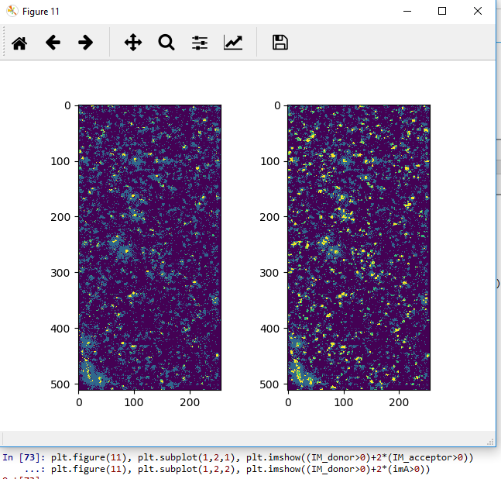
Left image: not aligned,
Right image: aligned
(overlap=yellow, more yellow in right image)
TO DO:
Better data set incl .map
Apply P&Q from .map
Is found COM of spot the one with highest intensity

